Slide 1
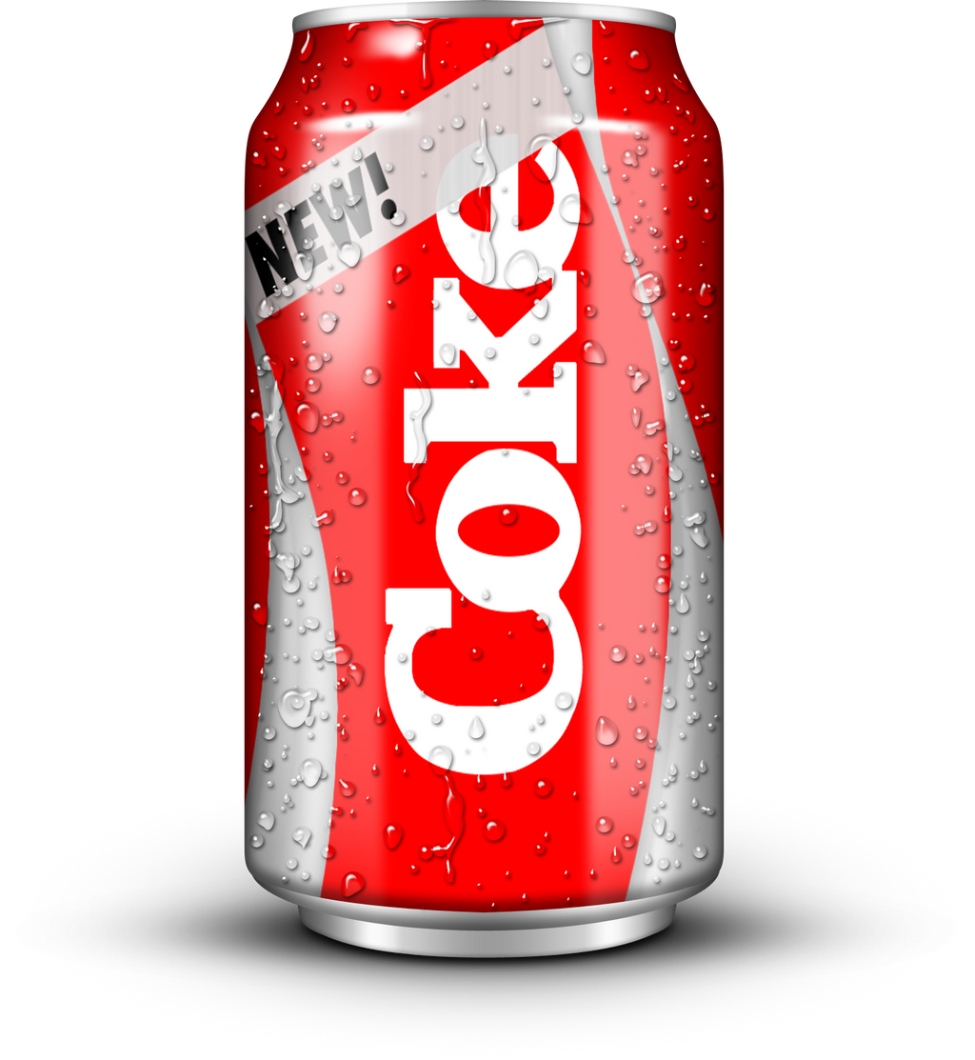
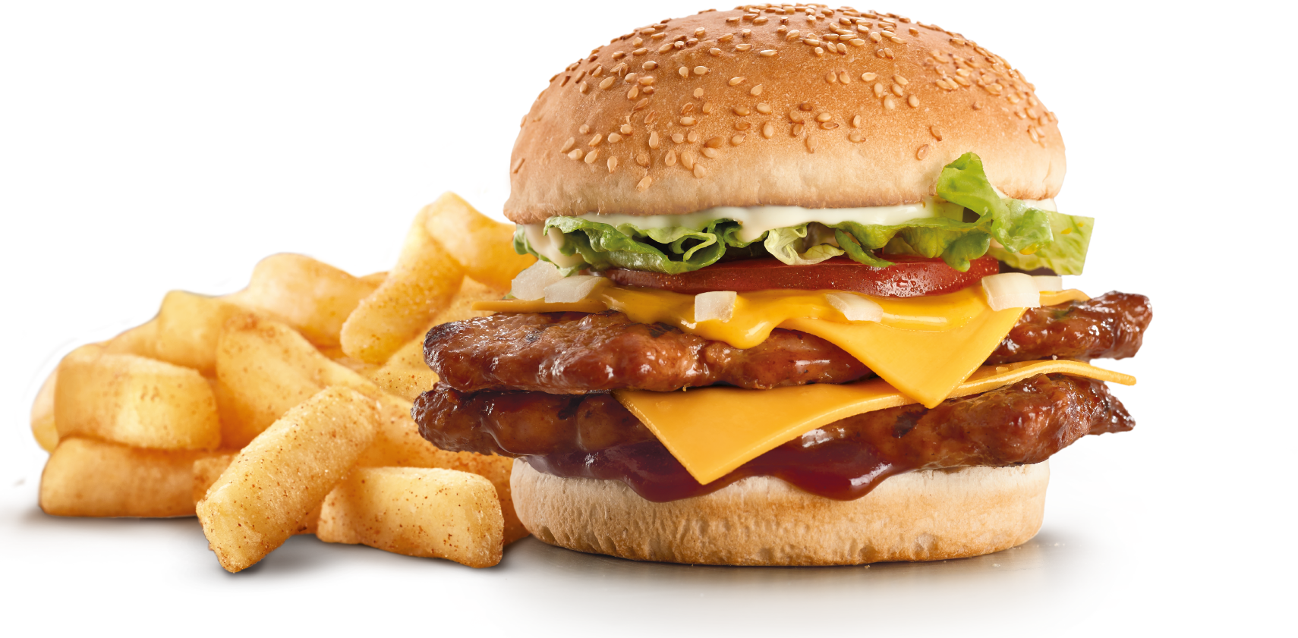
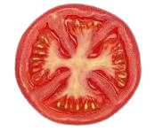




This Photo by Unknown Author is licensed under CC BY-SA
This Photo by Unknown Author is licensed under CC BY-SA

Slide 2
FRESH
BURGER
This Photo by Unknown Author is licensed under CC BY-SA
This Photo by Unknown Author is licensed under CC BY-SA

Slide 3
BEST BURGER IN THE TOWN
This Photo by Unknown Author is licensed under CC BY-SA
This Photo by Unknown Author is licensed under CC BY-NC
This Photo by Unknown Author is licensed under CC BY-SA
This Photo by Unknown Author is licensed under CC BY-SA

Slide 4
SPECIAL
OFFER
100/- ONLY

